Slide 1
Recent Breakthroughs and Uphill Battles in Modern Natural Language Processing
Daniel Khashabi
Notes:
I am Daniel Khashabi; for those who don’t know me, I am young investigator here at AI2.
And I am excited to tell you about our recent project!
This is a joint work with …
If you have any clarification questions, please interrupt me; otherwise, let’s delay all the open-ended questions till after the talk.

Slide 2

About me
Assistant Professor, Johns Hopkins University, Baltimore
Working on Artificial Intelligence & Natural Language Processing
PhD from University of Pennsylvania, 2019
BSc from Tehran Polytechnic, 2012

Slide 3
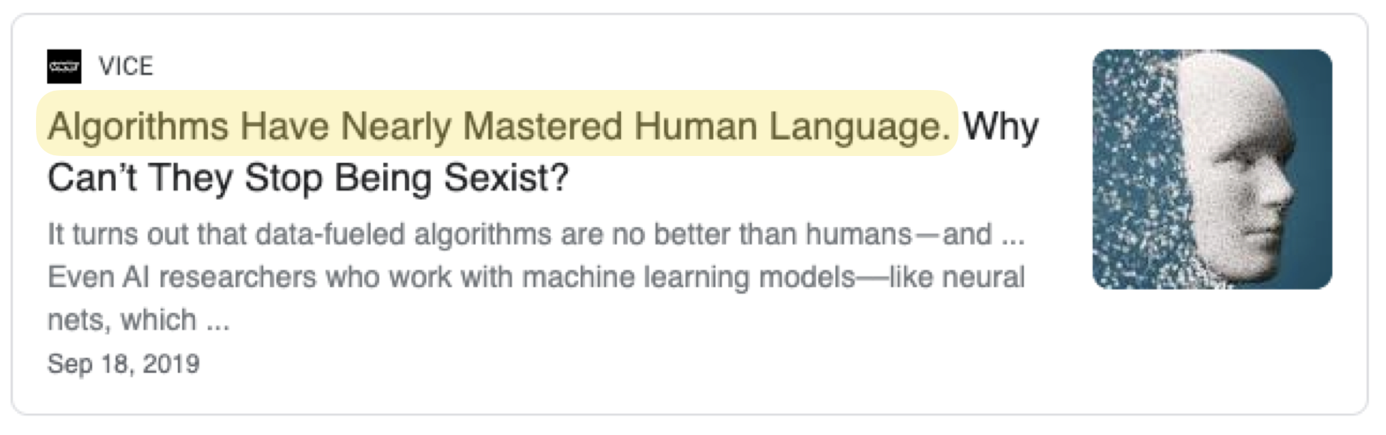
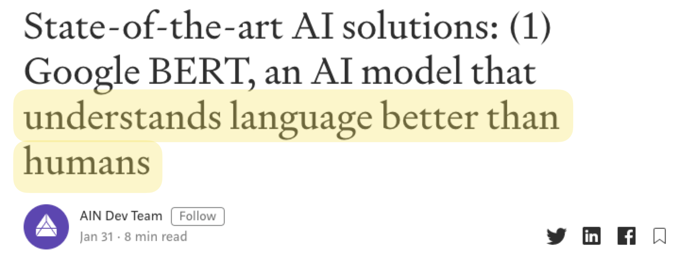
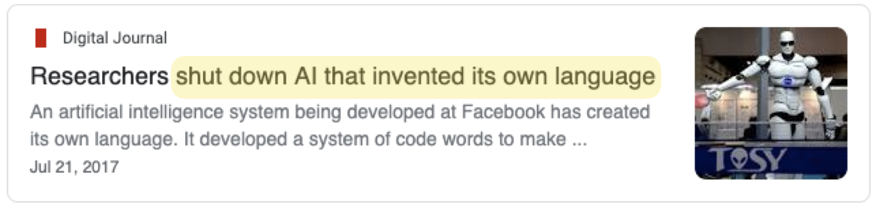
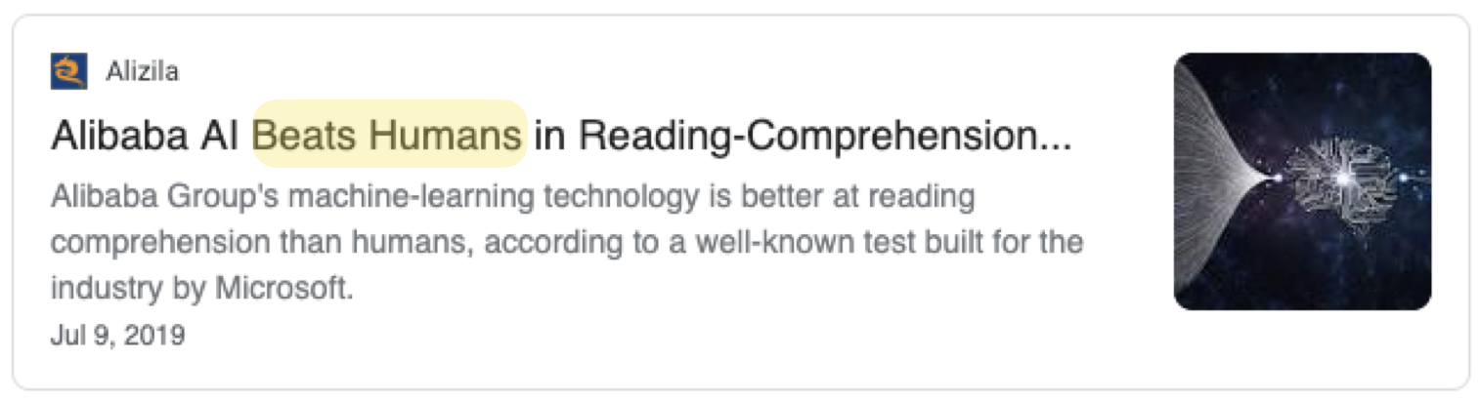
Popular Media: Language is solved!!

Slide 4
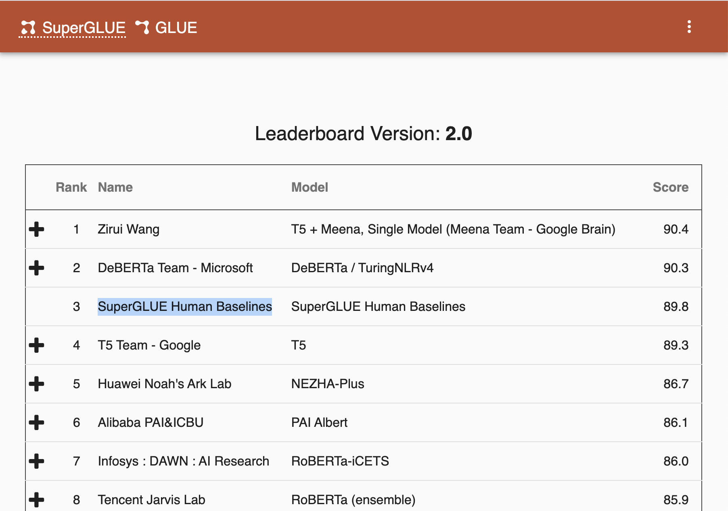
Leaderboards: NLP is on-par w/ humans
https://super.gluebenchmark.com/leaderboard

Slide 5
NLP in Production: some things work reasonably well
Auto-complete
Search
Question Answering
Grammar Correction
Translation
Dialog

Slide 6
Contextual Language Models
Unsupervised pre-training for building models of languages.
[Bengio et al. 2004, Hinton et al. 2006, Peters et al. 2018, …]
گربه سیاه همسایه موجب [MASK]
0.4 → خسارت
→0.2 وحشت
....
Language Model

Slide 7
Self-Supervised Models

Slide 8
Self-Supervised Models

Slide 9
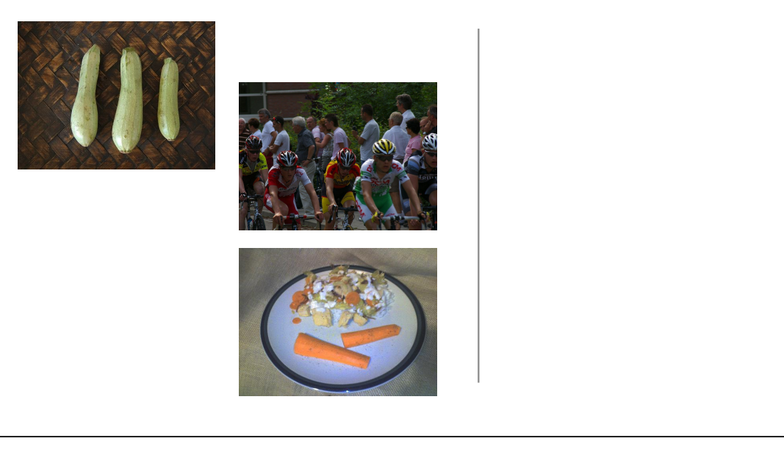
Self-Supervision
[Slide from Colin Raffel]
Notes:
what is generative modeling? Let's start with a example. Let's say I go out into the world and collect a dataset of natural images. So, first I get this picture of some cyclists…

Slide 10
Self-Supervision
[Slide from Colin Raffel]

Slide 11
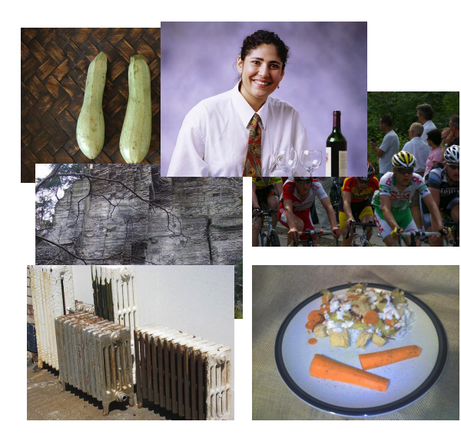
Self-Supervision
[Slide from Colin Raffel]
Notes:
And then a few more photos

Slide 12
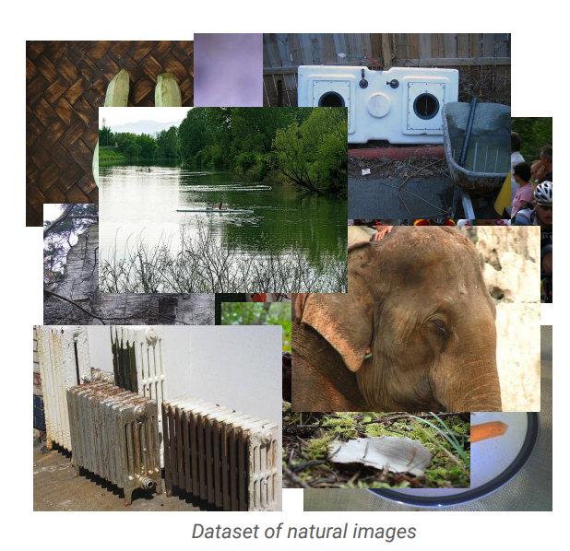
Self-Supervision
[Slide from Colin Raffel]
Notes:
And eventually I have a large collection of natural images. In generative modeling, we say that these images are samples from some true distribution - the distribution of natural images. The goal of generative modeling is to take this training set and learn a model which approximates this true distribution. That is, I hope to be able to draw new samples from my model which appear like real natural images, but are totally new and are not simply copies of entries from my training set.

Slide 13
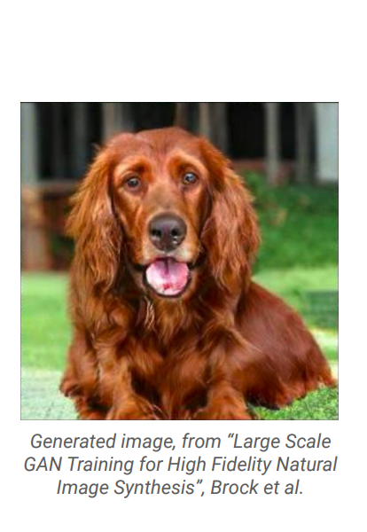
Self-Supervision
[Slide from Colin Raffel]
Notes:
Here's an example of an image produced by a recent generative model developed by some researchers at DeepMind. The generative model has made up this dog completely on its own - it’s only input is a random noise vector and the label “dog”. It has never seen this particular dog before in the training set, either. To my eyes at least, it's hard to tell that this is a generated image and not a real picture of a dog.

Slide 14
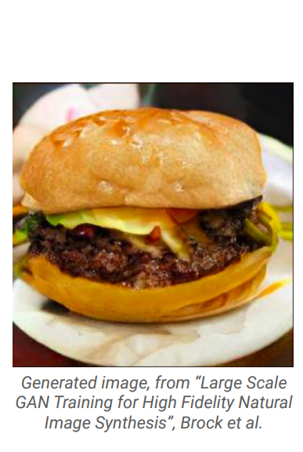
Self-Supervision
[Slide from Colin Raffel]
Notes:
And here's another one. I for one would be happy to eat this made-up cheeseburger. The fact that the model is able to produce these images suggests that it has learned about the structure of the natural world. The model has done this without explicit supervision - it was simply shown millions of images and discovered this structure itself.

Slide 15
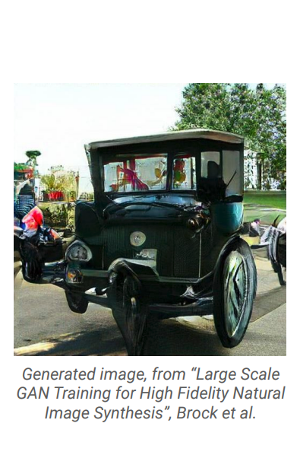
Self-Supervision
[Slide from Colin Raffel]
Notes:
Of course, this model is not perfect -- sometimes it generates things like this quasi-car.

Slide 16
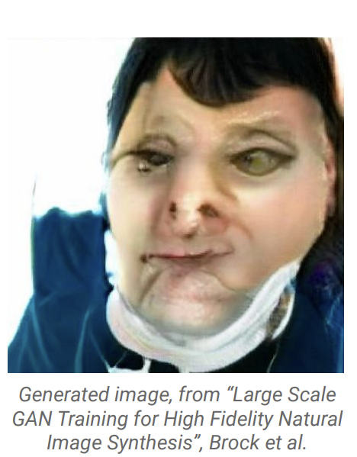
Self-Supervision
[Slide from Colin Raffel]
Notes:
Even worse, it hasn't really figured out what human faces look like. This is likely because the dataset it was trained on has a relatively low proportion of images of people’s faces. So while the results are quite impressive, there's still work to be done.

Slide 17
Self-Supervision
== treaty of paris (1763) the treaty of paris, also known as the treaty of 1763, was signed on 10 february 1763 by the kingdoms of great britain, france and spain, with portugal in agreement, after great britain's victory over france and spain during the seven years' war. the signing of the treaty formally ended the seven years' war, known as the french and indian war in the north american theatre, ….
[Slide from Colin Raffel]
Notes:
This same paradigm can be applied to other domains outside of natural images. For example, let's say we collect articles from Wikipedia.

Slide 18
Self-Supervision
== wheelbarrow
A wheelbarrow is a small hand-propelled vehicle, usually with just one wheel, designed to be pushed and guided by a single person using two handles at the rear, or by a sail to push the ancient wheelbarrow by wind. The term "wheelbarrow" is made of two words: "wheel" and "barrow." "Barrow" is a derivation of the Old English "barew" which was a device used for carrying loads. The wheelbarrow is designed to distribute the weight of its load between the wheel …
== treaty of paris (1763) the treaty of paris, also known as the treaty of 1763, was signed on 10 february 1763 by the kingdoms of great britain, france and spain, with portugal in agreement, after great britain's victory over france and spain during the seven years' war. the signing of the treaty formally ended the seven years' war, known as the french and indian war in the north american theatre, ….
[Slide from Colin Raffel]

Slide 19

Self-Supervision
== lemon
The lemon (Citrus limon) is a species of small evergreen trees in the flowering plant family Rutaceae, native to Asia, primarily Northeast India (Assam), Northern Myanmar or China.[2] The tree's ellipsoidal yellow fruit is used for culinary and non-culinary purposes throughout the world, primarily for its juice, which has both culinary and cleaning uses.[2] The pulp and rind are also used in cooking and baking. The juice of the lemon is about 5% to 6% citric acid, with a pH .…
== wheelbarrow
A wheelbarrow is a small hand-propelled vehicle, usually with just one wheel, designed to be pushed and guided by a single person using two handles at the rear, or by a sail to push the ancient wheelbarrow by wind. The term "wheelbarrow" is made of two words: "wheel" and "barrow." "Barrow" is a derivation of the Old English "barew" which was a device used for carrying loads. The wheelbarrow is designed to distribute the weight of its load between the wheel …
== treaty of paris (1763) the treaty of paris, also known as the treaty of 1763, was signed on 10 february 1763 by the kingdoms of great britain, france and spain, with portugal in agreement, after great britain's victory over france and spain during the seven years' war. the signing of the treaty formally ended the seven years' war, known as the french and indian war in the north american theatre, ….
Dataset of Wikipedia articles
[Slide from Colin Raffel]
Notes:
Once we have a large dataset of articles …

Slide 20
Self-Supervision
== lemon
The lemon (Citrus limon) is a species of small evergreen trees in the flowering plant family Rutaceae, native to Asia, primarily Northeast India (Assam), Northern Myanmar or China.[2] The tree's ellipsoidal yellow fruit is used for culinary and non-culinary purposes throughout the world, primarily for its juice, which has both culinary and cleaning uses.[2] The pulp and rind are also used in cooking and baking. The juice of the lemon is about 5% to 6% citric acid, with a pH .…
== wheelbarrow
A wheelbarrow is a small hand-propelled vehicle, usually with just one wheel, designed to be pushed and guided by a single person using two handles at the rear, or by a sail to push the ancient wheelbarrow by wind. The term "wheelbarrow" is made of two words: "wheel" and "barrow." "Barrow" is a derivation of the Old English "barew" which was a device used for carrying loads. The wheelbarrow is designed to distribute the weight of its load between the wheel …
== wings over kansas wings over kansas is the second studio album by jason ammons, john bolster and mo rosato. the album debuted at number one on the billboard 200, selling 35,000 copies in it first week at the time. it was the second highest selling album to debut at the billboard top 50 and the third highest selling album to debut at the top heatseekers, with 26,000 copies sold. this is the supremes album earning the nickname nitty gritty but their other two singles by the band in …
== treaty of paris (1763) the treaty of paris, also known as the treaty of 1763, was signed on 10 february 1763 by the kingdoms of great britain, france and spain, with portugal in agreement, after great britain's victory over france and spain during the seven years' war. the signing of the treaty formally ended the seven years' war, known as the french and indian war in the north american theatre, ….
Dataset of Wikipedia articles
[Slide from Colin Raffel]
Notes:
we can train a generative model to generate new Wikipedia articles. This example comes from work done by researchers at Google Brain. In this case, the generated article discusses a made-up album called Wings over Kansas. The model was only given the title of the article and filled in the rest. You can see that the model has learned not only basic sentence structure, grammar, and spelling, but also the kind of content which is typical in Wikipedia articles. It also stays on theme, though it does end up generating some nonsense near the end.

Slide 21
Self-Supervised Models

Slide 22
Self-Supervised Models

Slide 23
Self-Supervised Models

Slide 24
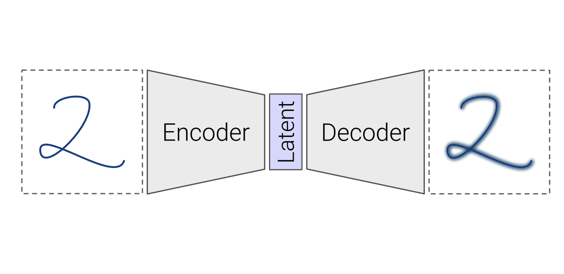
Self-Supervised Models
Mask
[Bengio et al. 2004, Hinton et al. 2006, Peters et al. 2018, …]
Notes:
The autoencoders is a simple model structure whose goal is to reconstruct its input. The input is first mapped to a latent code, which is typically lower-dimensional than the input. The encoder tries to encode all of the useful information about the input into into the latent code, and the decoder tries to reconstruct the input based only on the information in the latent. The model is typically trained against a reconstruction error cost such as mean squared error, which measures how closely the reconstruction matches the input.
Slide from: https://colinraffel.com/talks/vector2018few.pdf

Slide 25
Self-Supervised Models
“Wings over Kansas is an aviation website founded in 1998 by Carl Chance owned by Chance Communications, Inc.”
“Wings over Kansas is [MASK]”
[Bengio et al. 2004, Hinton et al. 2006, Peters et al. 2018, …]
Notes:
The autoencoders is a simple model structure whose goal is to reconstruct its input. The input is first mapped to a latent code, which is typically lower-dimensional than the input. The encoder tries to encode all of the useful information about the input into into the latent code, and the decoder tries to reconstruct the input based only on the information in the latent. The model is typically trained against a reconstruction error cost such as mean squared error, which measures how closely the reconstruction matches the input.
While it’s fun to train a model to generate new made-up Wikipedia articles from scratch, it’s not terribly useful on its own since there are already so many Wikipedia articles out there already. One of the things that makes generative models useful in practice is that they provide a means to leverage and discover structure in large unlabeled datasets. In machine learning, we often find gains simply from collecting more data. In many applications like modeling text or natural images, unlabeled data is almost limitless.

Slide 26
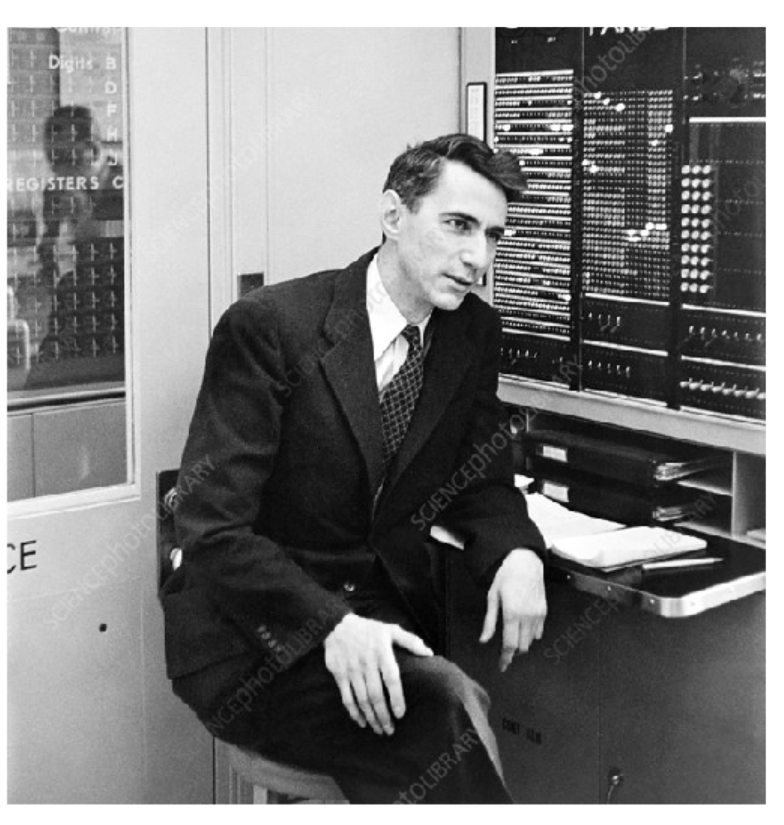
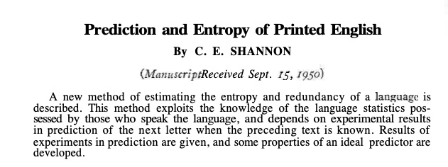
Self-Supervised Models: A History
Shannon (1950) the entropy of English — i.e., its predictive difficulty.

Slide 27
✓ Self-supervised models are predictive models of the world.

Slide 28
Encoder Decoder Models
EOS
شد
خسارات
موجب
همسایه
سیاه
گربه
decoder
encoder
Translation (e.g., Google Translate)
Grammatical Error Correction (Grammarly, etc.)
Email response suggestion (Gmail, Outlook, etc.)

Slide 29
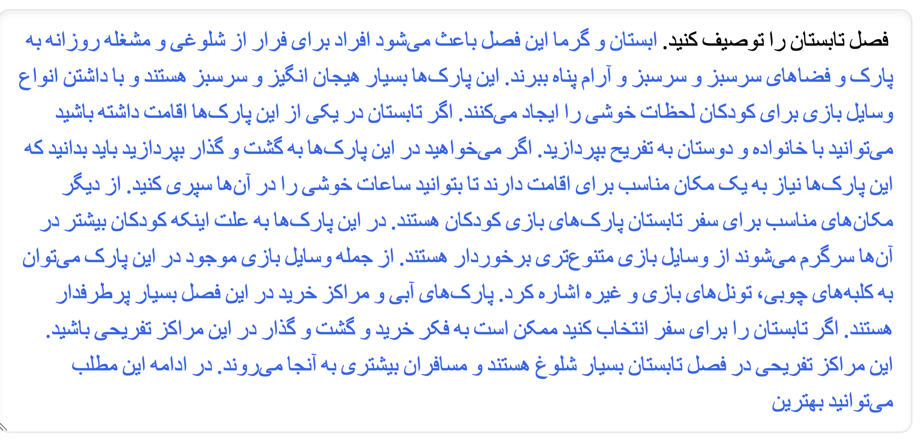
Encoder-Decoders: Example
https://huggingface.co/flax-community/gpt2-medium-persian

Slide 30

Encoder-Decoders: Example
https://6b.eleuther.ai/

Slide 31
✓ Language models are convenient frameworks for text-in text-out tasks.

Slide 32
Self-Supervised Models
For What End Though?
Many tasks we care about* are tightly connected to predictive models of the world!
* Thus far

Slide 33
Self-Supervised Models and End Tasks
Goal: Answering questions
Question: “Where is the birthplace of the American national anthem?”
✍️
“The birthplace of the American national anthem, "The Star-Spangled Banner," lies in Baltimore, Maryland.”
“The birthplace of the American national anthem [MASK]”
Produced with GPT-J: https://6b.eleuther.ai/
Notes:
A good example of the power of this is some recent work from OpenAI, where they demonstrate that by training a large generative text model on a huge corpus of documents from the web, they obtain state-of-the-art results on many common text benchmarks. These results are obtained with a simple type of generative model which is particularly effective at learning about the structure of text and language from unlabeled data alone. These impressive results are largely thanks to the fact that they were able to trained a large generative model on lots of unlabeled data.

Slide 34
Self-Supervised Models and End Tasks
Goal: Sentiment classification
Review: “While this restaurant is popular on Google, I absolutely disliked it.”
✍️
“We want to decide whether the sentiment of the review is "positive" or "negative".
Review: "While this restaurant is popular on Google, I absolutely disliked it".
The sentiment of this review is [MASK]”
“...is negative.”
Produced with GPT-J: https://6b.eleuther.ai/

Slide 35
✓ Self-supervised models
The resulting representations are closely tied to the end tasks
Traditionally addressed by supervised learning
Learning from unlabeled data
A special case of unsupervised learning

Slide 36
In-context Learning w/ Self-Supervised Models
Goal: Sentiment classification
Tweet: “I hate when my phone battery dies” Sentiment: Negative.
Tweet: “My day has been fine.”
Sentiment: Positive.
Tweet: “This phone is useless!” Sentiment: Negative.
Review: "I absolutely disliked it".
Sentiment:
“... negative.”
Produced with GPT-J: https://6b.eleuther.ai/

Slide 37
In-context Learning w/ Self-Supervised Models
Goal: Sentiment classification
جمله: این رستوران خیلی بده!‌ احساس: منفی جمله: غذاش خیلی خوب بود!‌ احساس: مثبت جمله:‌ فضاش بد نبود اما در کل لذت نبردم. احساس: منفی جمله: بهترین رستورانی بود که امتحان کرده بودم. احساس:
“مثبت”
Produced with GPT-J: https://huggingface.co/bolbolzaban/gpt2-persian

Slide 38
✓ In-context prompting of language models is a convenient way to make them solve tasks, without additional training.

Slide 39
Fine-tuning Language Models
Gold label
Language Model
Classifier
input
prediction
loss

Slide 40
✓ Language models are trained once, then fine-tuned for each task with few examples.

Slide 41
New Age of NLP
Pre-1993: Rule based NLP
1993 - 2020: Statistical NLP
2020: Language Model based NLP
The manner in which we have started to do NLP is qualitatively different from before

Slide 42


Scaling Self-Supervised Models
Larger pre-training datasets
cheap freely-available text
1GB
10GB
10TB
Notes:
These are some applications of language understanding for the context, and many of these have seem performance improvements in the past few years due to advent of deep learning.
So much so that some people got the impression that AI systems are closing in on human intelligence and …
Under the hood, these improvements are due to new developments on how neural networks are supervised with freely-available data, such as raw web text.
To be more concrete,
- self-supervised learning → gives some level of generality, but not enough
- increasingly large pre-training data
- increasingly larger models
Progresses are made, but we have a long way to go:
- LMs have an understanding of language structure → making it a useful representation tool
We need more:
- must generalize to many new tasks with essentially no retraining
- explaining, rationalizing and understanding the decisions
- imagining possible alternatives that haven’t happened yet
- planning actions for future
- models that actively revise their knowledge/decisions based on the feedback of their environment (and that includes both successes and failures)
- sharing our social and ethical values …
So in order to introduce such attributes we need a lot of work and progress to capture these.
- Tasks that we want to solve They are hard to control
During my PhD, I have taken several steps toward this broader goal, along these three methodological directions:
- ….
Eval
Repr
Symbolic
In this talk, I am going to focus on three projects specifically:

Slide 43
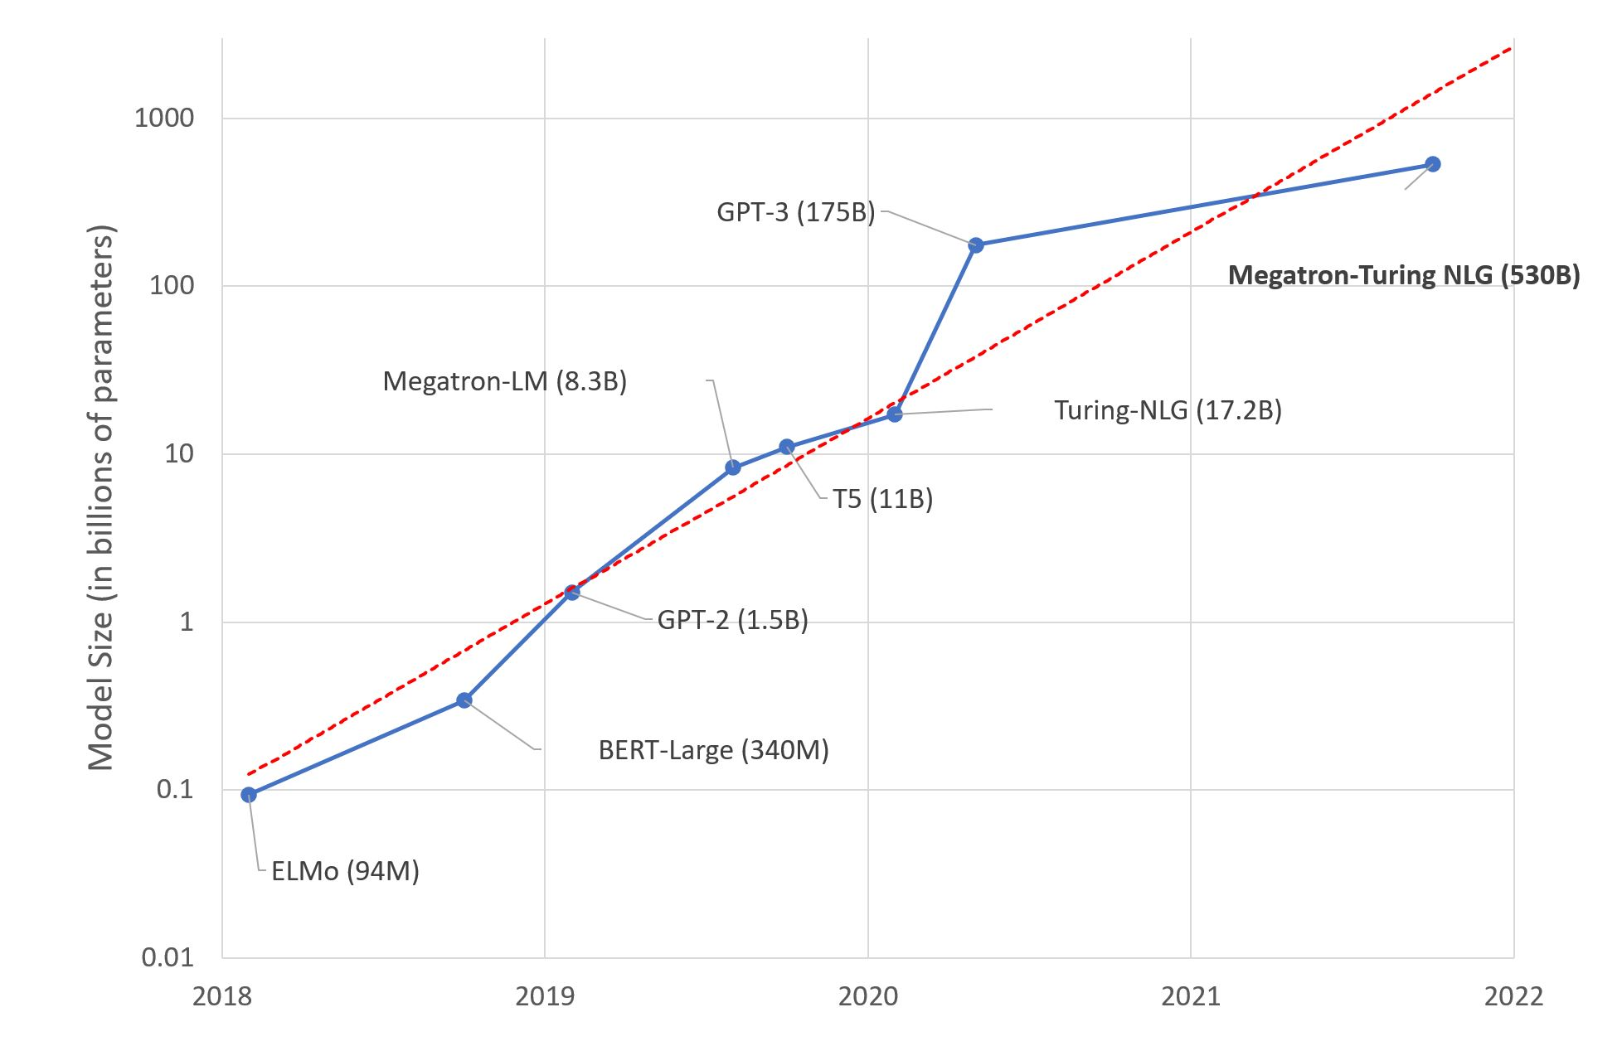
Scaling Self-Supervised Models
Larger pre-training datasets
Larger models
Notes:
These are some applications of language understanding for the context, and many of these have seem performance improvements in the past few years due to advent of deep learning.
So much so that some people got the impression that AI systems are closing in on human intelligence and …
Under the hood, these improvements are due to new developments on how neural networks are supervised with freely-available data, such as raw web text.
To be more concrete,
- self-supervised learning → gives some level of generality, but not enough
- increasingly large pre-training data
- increasingly larger models
Progresses are made, but we have a long way to go:
- LMs have an understanding of language structure → making it a useful representation tool
We need more:
- must generalize to many new tasks with essentially no retraining
- explaining, rationalizing and understanding the decisions
- imagining possible alternatives that haven’t happened yet
- planning actions for future
- models that actively revise their knowledge/decisions based on the feedback of their environment (and that includes both successes and failures)
- sharing our social and ethical values …
So in order to introduce such attributes we need a lot of work and progress to capture these.
- Tasks that we want to solve They are hard to control
During my PhD, I have taken several steps toward this broader goal, along these three methodological directions:
- ….
Eval
Repr
Symbolic
In this talk, I am going to focus on three projects specifically:

Slide 44
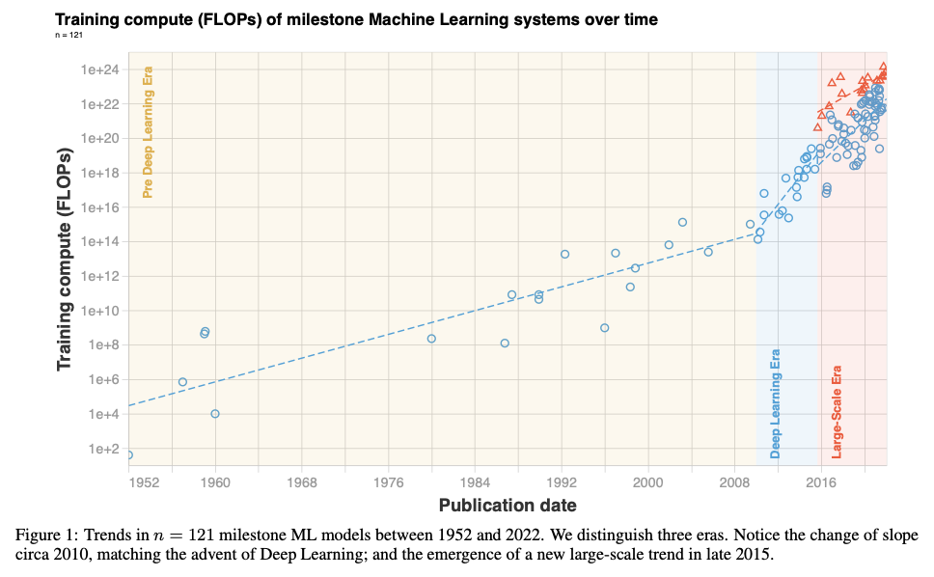
Scaling Self-Supervised Models
Larger pre-training datasets
Larger models
Sevilla, Jaime, Lennart Heim, Anson Ho, Tamay Besiroglu, Marius Hobbhahn, and Pablo Villalobos. "Compute trends across three eras of machine learning." arXiv preprint arXiv:2202.05924 (2022).
Notes:
These are some applications of language understanding for the context, and many of these have seem performance improvements in the past few years due to advent of deep learning.
So much so that some people got the impression that AI systems are closing in on human intelligence and …
Under the hood, these improvements are due to new developments on how neural networks are supervised with freely-available data, such as raw web text.
To be more concrete,
- self-supervised learning → gives some level of generality, but not enough
- increasingly large pre-training data
- increasingly larger models
Progresses are made, but we have a long way to go:
- LMs have an understanding of language structure → making it a useful representation tool
We need more:
- must generalize to many new tasks with essentially no retraining
- explaining, rationalizing and understanding the decisions
- imagining possible alternatives that haven’t happened yet
- planning actions for future
- models that actively revise their knowledge/decisions based on the feedback of their environment (and that includes both successes and failures)
- sharing our social and ethical values …
So in order to introduce such attributes we need a lot of work and progress to capture these.
- Tasks that we want to solve They are hard to control
During my PhD, I have taken several steps toward this broader goal, along these three methodological directions:
- ….
Eval
Repr
Symbolic
In this talk, I am going to focus on three projects specifically:

Slide 45
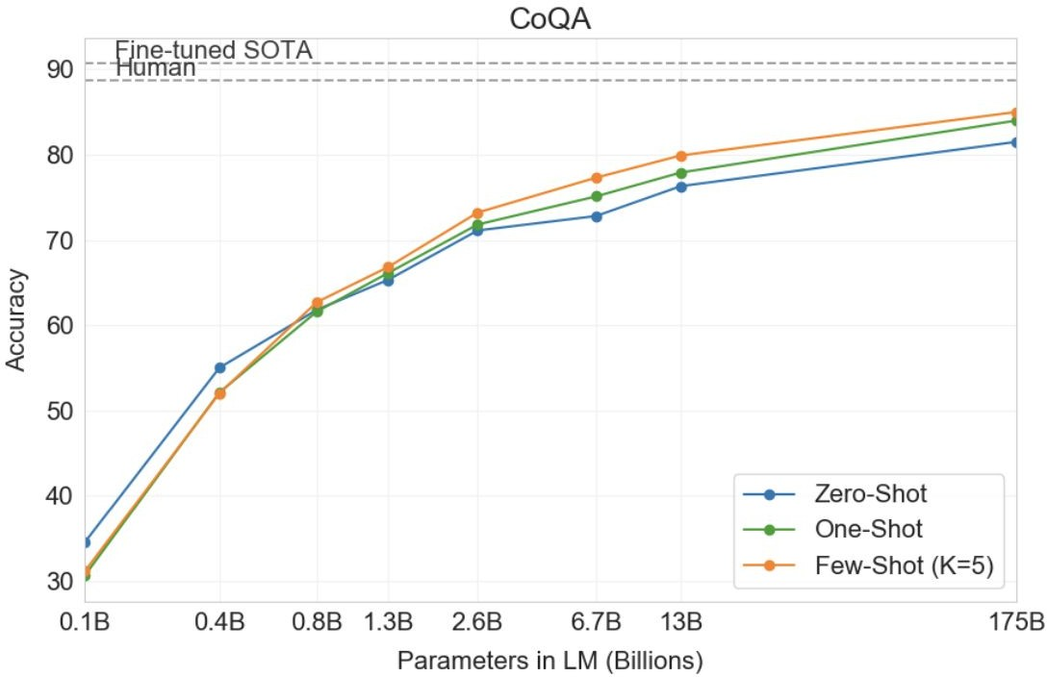
In-context learning results
34
Brown et al. 2020. “Language Models are Few-Shot Learners”

Slide 46
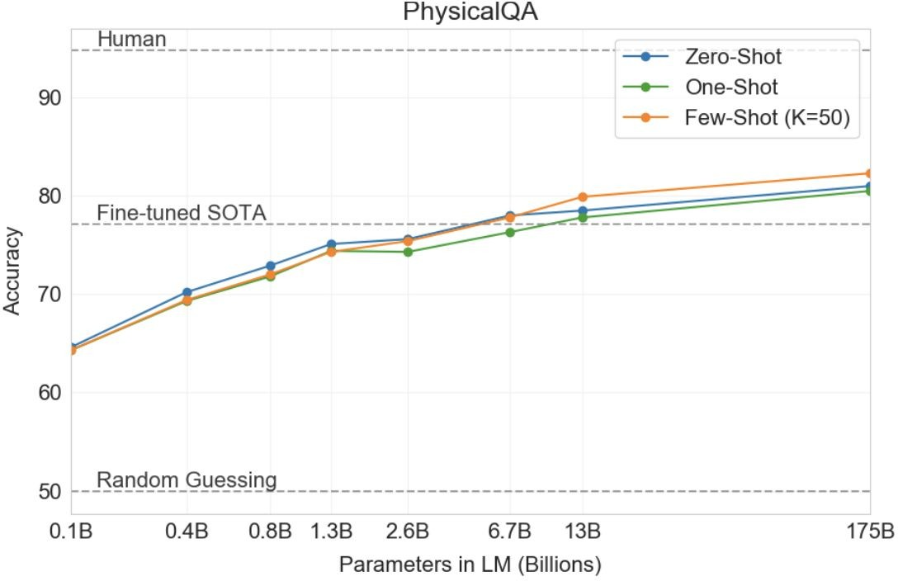
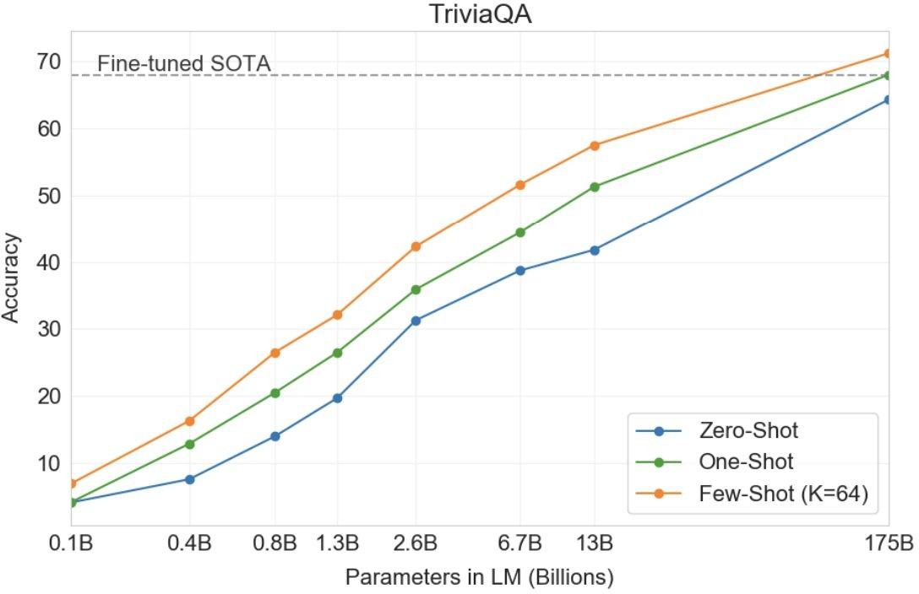
Scaling Self-Supervised Models
35
Brown et al. 2020. “Language Models are Few-Shot Learners”

Slide 47
✓ Scaling language models consistently lead to stronger models.

Slide 48
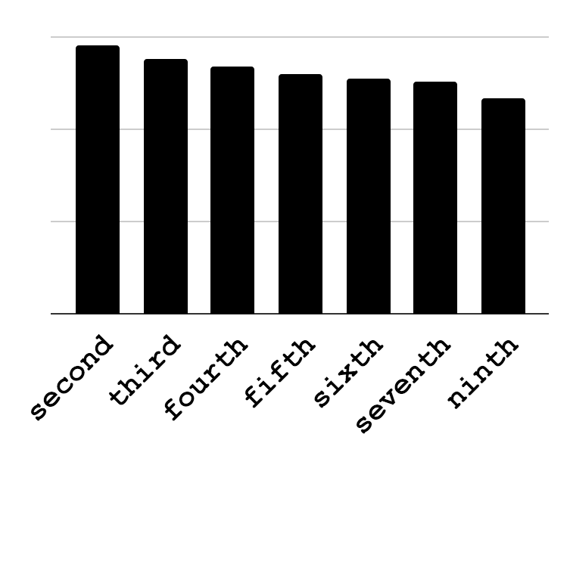
Language Models: Means to Access Knowledge
They let you “query” for knowledge:
⬤ | ⬤ | ⬤
⬤ | ⬤ | ⬤
⬤ | ⬤ | ⬤
ELMo
[Peters et al.18]
… vacation in Paris …
Other works:
[Devlin et al.18; Radford et al.18]
Pittsburgh is the ____ -largest populated city in Pennsylvania.
Notes:
So far, the field has been using such models in a few narrow sense; for instance taking their results and using them as features in your feature-rich machine learning models.
However, one thing that I am excited about is that, such models let you directly look into what is inside them, with explicit queries, in the form of natural language.
For instance, I can issue queries like this about the size of Pittsburgh and it comes back a response like this.
In a sense, what it gives me is a distillation of many pattern that it has seen on the web, possibly about Pittsburgh.

Slide 49
✓ Language models serve as efficient mechanisms for knowledge retrieval.

Slide 50
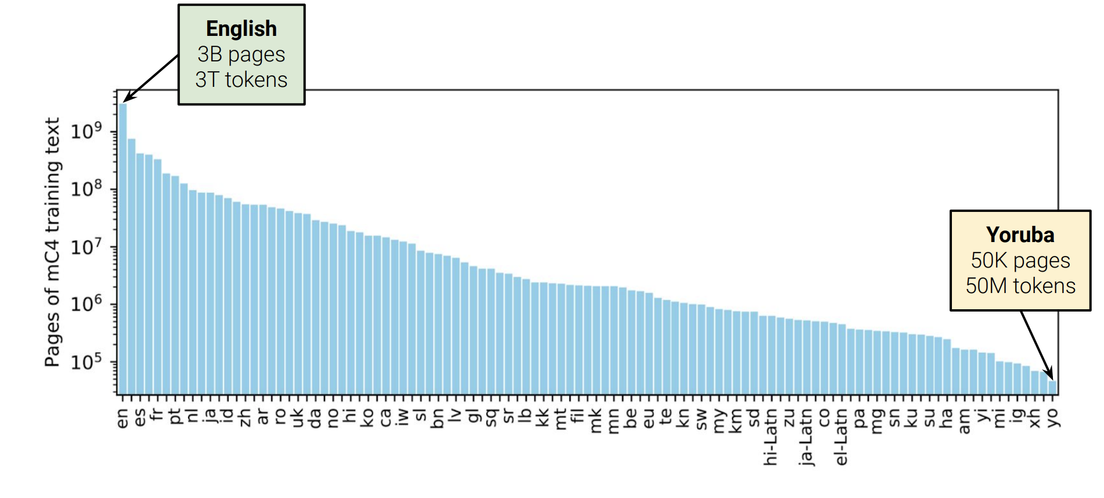
Multilinguality
Pre-train on a many languages
mT5: https://github.com/google-research/multilingual-t5
multilingual bert: https://huggingface.co/bert-base-multilingual-cased

Slide 51
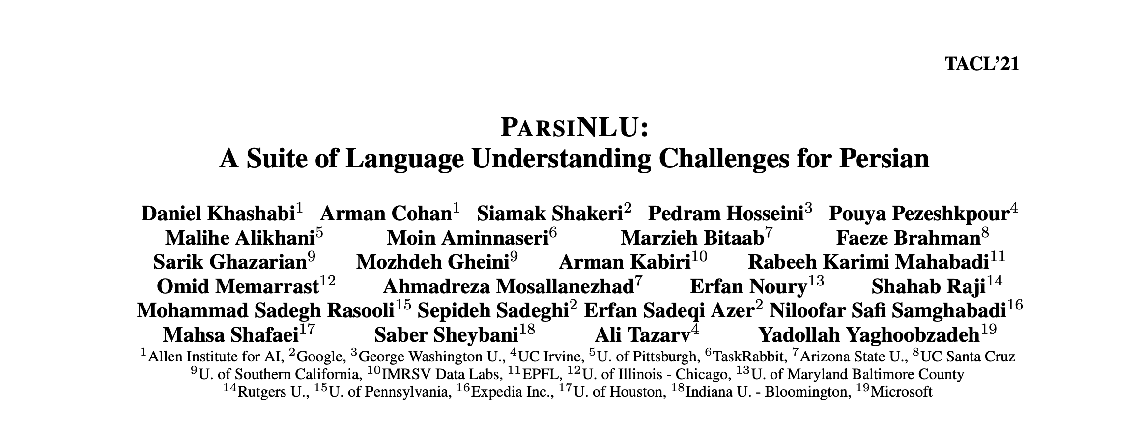
Benchmarking LMs in Persian
A Persian language understanding benchmark.
https://github.com/persiannlp/parsinlu

Slide 52
ParsiNLU Tasks
Reading Comprehension
سوال: نهاوند جزو کدام استان است؟
Question: Nahavand is part of which province?
پاراگراف: نَهاوند شهری در غرب ایران است. این شهر در جنوب غربی استان همدان قرار گرفته است. نهاوند دارای حمعیت …
Paragraph: Nahavand (Navan) is a city in western Iran. This city is located in the southern part of Hamedan province and it is the capital of Nahavand. Nahavand has a population of …
پاسخ: همدان، استان همدان
Answer: Hamedan; Hamedan province
Notes:
Reading comprehension is defined as the task of extracting a substring from a given context paragraph that answers a given question.
Here is an example ….

Slide 53
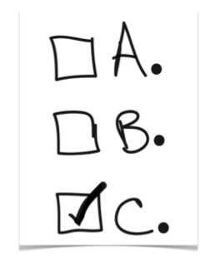
ParsiNLU Tasks
Reading Comprehension
Multiple-Choice Question Answering
بزرگترین قاره‌ی جهان کدام است؟‌
✔ ۱) آسیا ۲)‌ اروپا ۳) آمریکا ۴) آفریقا
What is the largest continent in the world?
✔ 1) Asia 2) Europe 3) Americas 4) Africa
Notes:
Reading comprehension is defined as the task of extracting a substring from a given context paragraph that answers a given question.
Here is an example ….

Slide 54
ParsiNLU Tasks
Reading Comprehension
Multiple-Choice Question Answering
Sentiment Analyses
Textual Entailment
Paraphrasing
Machine Translation
Notes:
Reading comprehension is defined as the task of extracting a substring from a given context paragraph that answers a given question.
Here is an example ….

Slide 55
Benchmarking LMs in Persian
قاره آمریکا در چه سالی کشف شد؟
یش از ده هزار سال است که انسان‌ها در قارهٔ آمریکا زندگی می‌کنند. قاره آمریکا توسط کریستف کلمب و در سال ۱۴۹۲ کشف شد اما او به اشتباه فکر کرد که آنجا هندوستان است اما مدت‌ها بعد آمریگو وسپوچی اعلام کرد که این قاره جدیدی است. اما تاریخ آمریکا به عنوان یک کشور مستقل به سال ۱۷۸۳ میلادی بازمی‌گردد که در آن آمریکا بر طبق معاهدهٔ پاریس به رسمیت شناخته گردید
Language Model
۱۴۹۲
https://github.com/persiannlp/parsinlu
https://huggingface.co/persiannlp

Slide 56

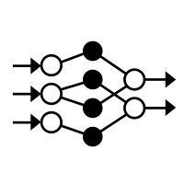
Experiments: Setup
Human performance:
Evaluate annotations from three human annotatorsagainst the gold labels
Model performance:
Trained a variety of models
ParsBERT [Farahani et al. 2020]
wikiBERT [Xue et al. 2021]
mBERT [Devlin et al. 2019]
mT5 [Xue et al. 2021]
Persian LM
Multilingual LM
Notes:
We conduct a relatively comprehensive set of experiments on the collected data.
To have an estimate of the performance and the difficulty of the challenges, we report human performance on a random subset (100-150) of instances from each task.
We collect annotations from three human annotators, adjudicate the inconsistencies and evaluate it against the gold labels to estimate human performance for each task
For evaluation of our baselines, we use state-of-the-art LMs:
some multilingual LMs that pretrained on many languages including Persian (such as m BERT and mT5)
and some pre-trained only for Persian
For each task, we train models with various hyper-parameters and select the best one according to their developement set performance.

Slide 57
Experimental Findings (1)
Finding 1: The proposed dataset(s) is decent quality.
Human:
86.2
70.4
Performance (F1)
49.0
49.2
39.2
40.7
mT5
(large)
mT5
(XL)
WikiBERT
(base)
ParsBERT
(base)
mBERT
(base)
LMs trained on
ParsiNLU Reading Comprehension
Notes:
Here we’re highlighting empirical results for reading comprehension only, since the trends are mostly similar for other remaining tasks.
The first lesson is about dataset’s quality:
The estimated human scores provide an indication of a reasonable degree of consensus between the ground-truth and judgments of native speakers and hence, the quality of our dataset.
In terms of model performances:
We measure LM’s performance, when trained with Persian labeled data,

Slide 58
Experimental Findings (2)
Finding 1: The proposed dataset(s) is decent quality.
Finding 2: English models successfully transfer to Persian.
Human:
86.2
70.4
67.4
68.2
Performance (F1)
49.0
49.2
39.2
40.7
mT5
(large)
mT5
(XL)
mT5
(large)
mT5
(XL)
WikiBERT
(base)
ParsBERT
(base)
mBERT
(base)
LMs trained on
ParsiNLU Reading Comprehension
LMs trained on
SQuAD
Notes:
Models trained on English dataset (and show surprising generalizatio to our Persian evaluation data)

Slide 59
Experimental Findings (3)
Finding 1: The proposed dataset(s) is decent quality.
Finding 2: English models successfully transfer to Persian. Joint training on English and Persian helps.
Human:
86.2
73.6
74.7
70.4
67.4
68.2
Performance (F1)
49.0
49.2
39.2
40.7
mT5
(large)
mT5
(XL)
mT5
(large)
mT5
(XL)
mT5
(large)
mT5
(XL)
WikiBERT
(base)
ParsBERT
(base)
mBERT
(base)
LMs trained on
ParsiNLU Reading Comprehension
LMs trained on
SQuAD
LMs trained on
ParsiNLU Reading Comprehension +
SQuAD
Notes:
And models trained on a union of PErsian and English datasets, which worked the best.

Slide 60
Experimental Findings (4)
Finding 1: The proposed dataset(s) is decent quality.
Finding 2: English models successfully transfer to Persian. Joint training on English and Persian helps.
Finding 3: ParsiNLU has room for progress.
Human:
86.2
73.6
74.7
70.4
67.4
68.2
Performance (F1)
49.0
49.2
39.2
40.7
mT5
(large)
mT5
(XL)
mT5
(large)
mT5
(XL)
mT5
(large)
mT5
(XL)
WikiBERT
(base)
ParsBERT
(base)
mBERT
(base)
LMs trained on
ParsiNLU Reading Comprehension
LMs trained on
SQuAD
LMs trained on
ParsiNLU Reading Comprehension +
SQuAD
Notes:
And finally, the majority of the models lag behind human performance with a sizable margin, which indicates that … [read]
This is especially true for tasks like multiple-choice QA that human performance is about 40% ahead of the model performance.

Slide 61
✓ Multi-lingual LMs have been successful in transfer across languages.

Slide 62

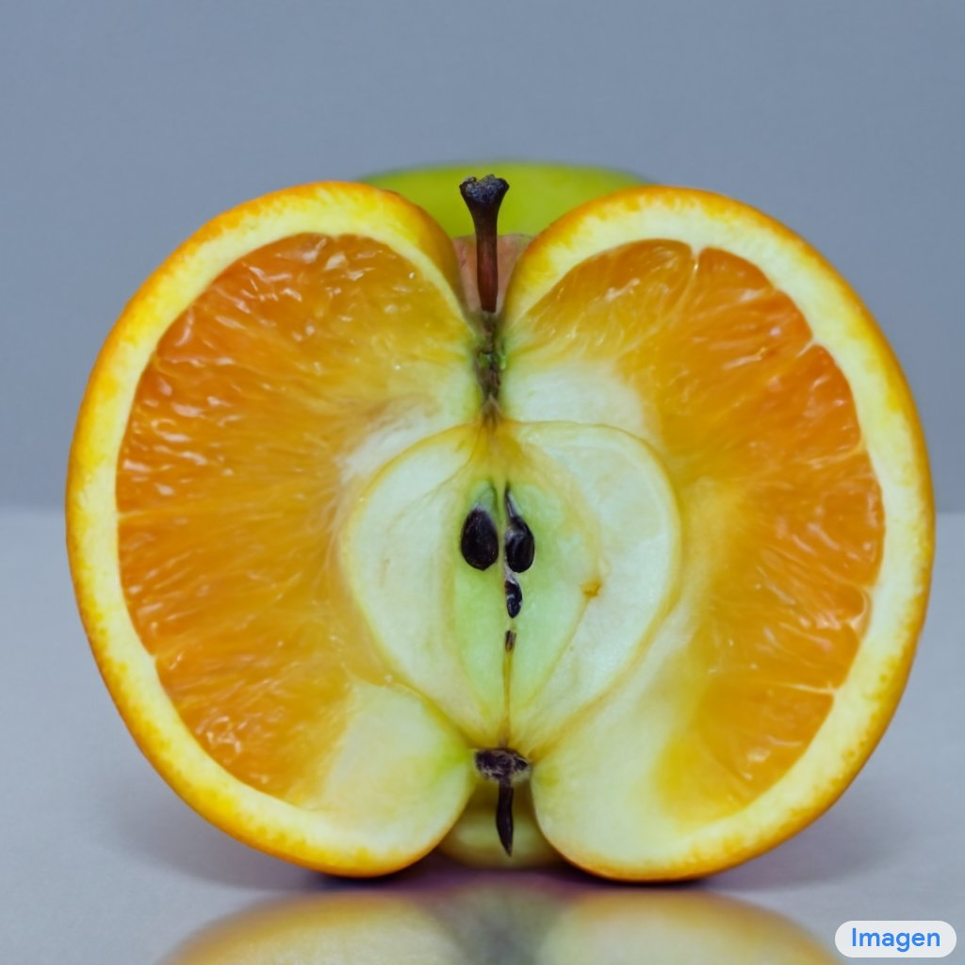
Image-Text Models
an invisible man, wearing glasses and sitting at a desk in front of a computer"
one piece of fruit that's apple on the outside, orange texture on the inside, cut in half
https://openai.com/dall-e-2/
https://imagen.research.google/

Slide 63
✓ Multi-modal have shown successful transfer across different modalities.

Slide 64
Is NLP solved? Are we done? 🤔

Slide 65


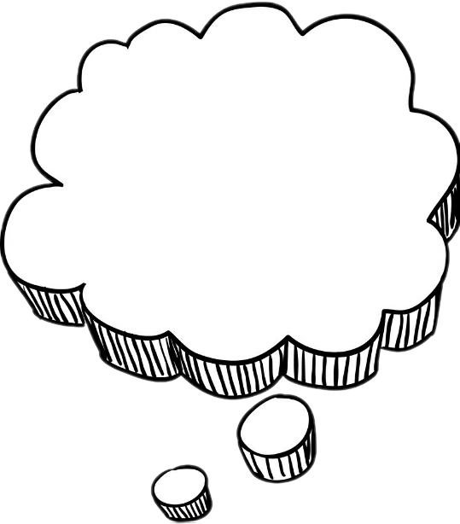
Humans Generalize from Few Examples
Abstract cat
The cat drinks.
The cat eats.
The cat sleeps.
The cat eats.

Slide 66
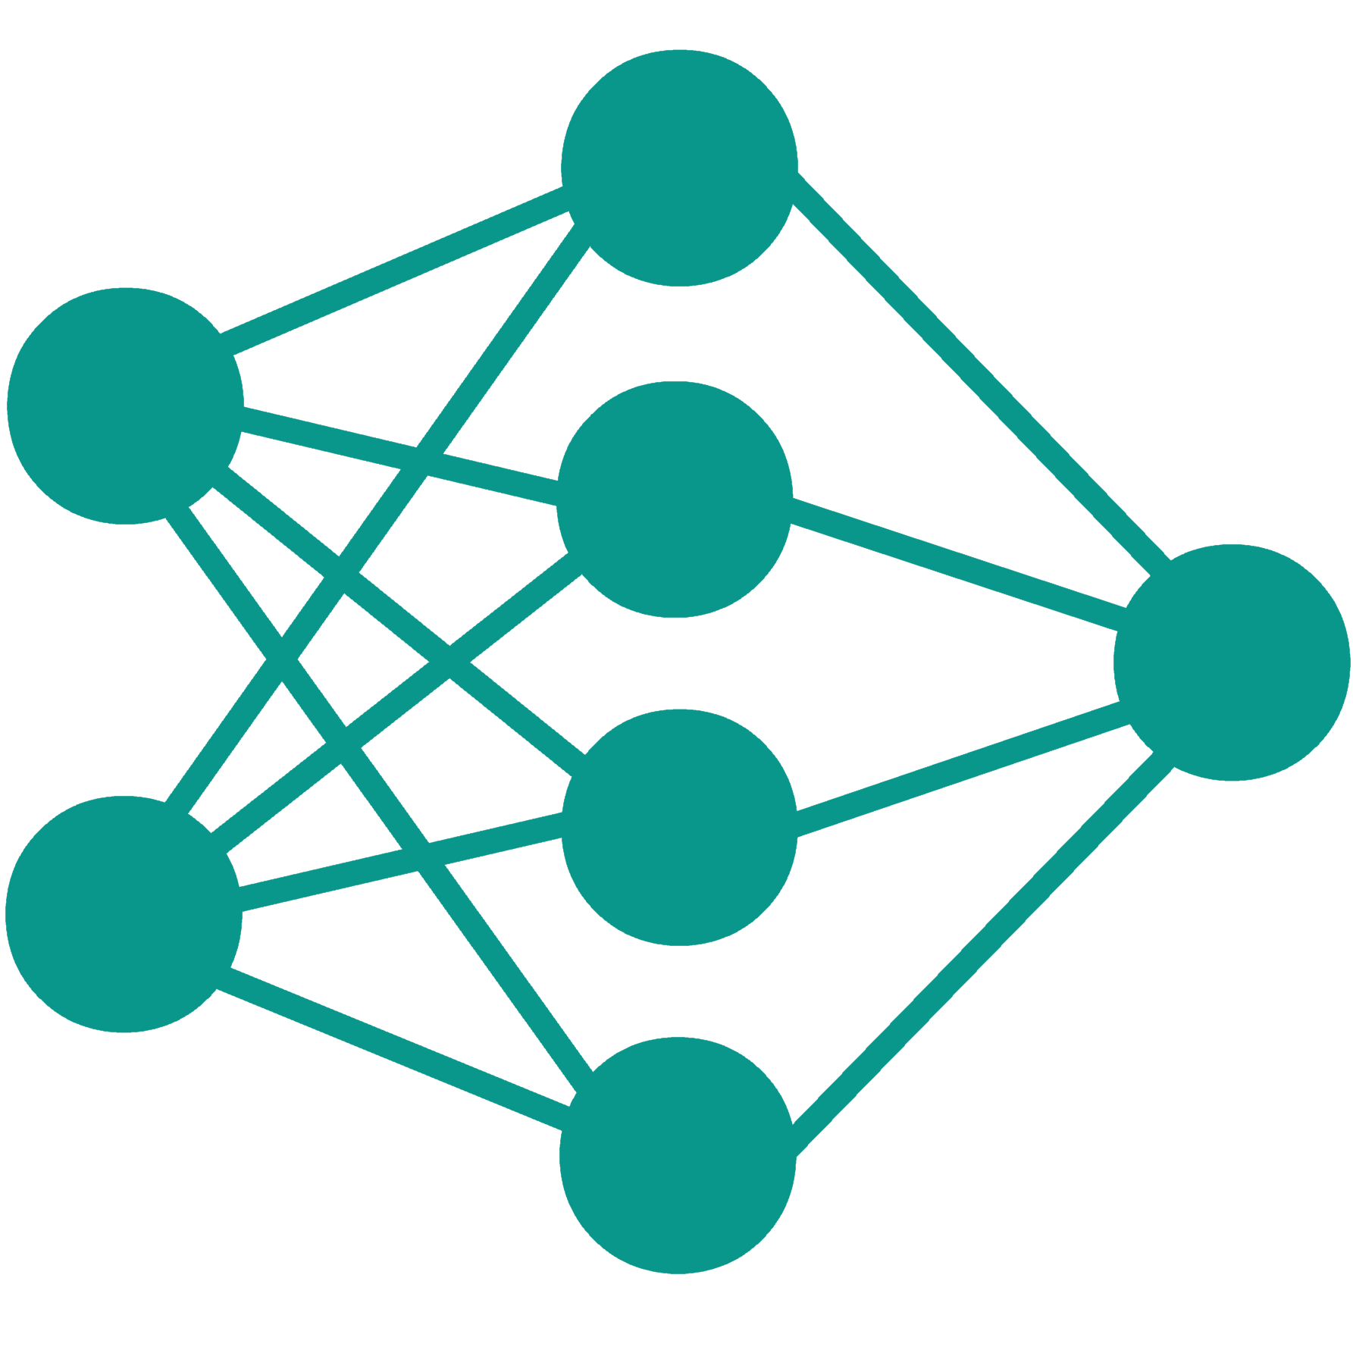

Machines Need Many Examples
Training
The cat eats.
Inference
???
???
???

Slide 67
x Our computational models are data-hungry!

Slide 68
NLP in Production
Auto-complete
Search
Question Answering
Grammar Correction
Translation
Dialog
They work well in domains where data is available.

Slide 69
Data scarcity in other languages
Example: Google Translate
“The number of parallel sentences […] ranges from around tens of thousands to almost 2 billion.”
Massively multilingual neural machine translation in the wild: Findings and challenges. Arivazhagan, Naveen, et al. arXiv 2019.

Slide 70
Brittleness with respect to small changes
Context: In the United States especially, several high-profile cases such as Debra LaFave, Pamela Rogers, and Mary Kay Letourneau have caused increased scrutiny on teacher misconduct.
Question: What has been the result of this publicity?
“increased scrutiny on teacher misconduct”
What’s
“teacher misconduct”
[K at al. 2016; Jia et al. 2017; Gardner et al. 20; others]
Notes:
Well, ... alongside the apparent progress, there are troubling trends as well.
You take a SOTA system, run it on an instance taken it is used to seeing and things work well.
You make small changes to the instance, and things fall apart.

Slide 71
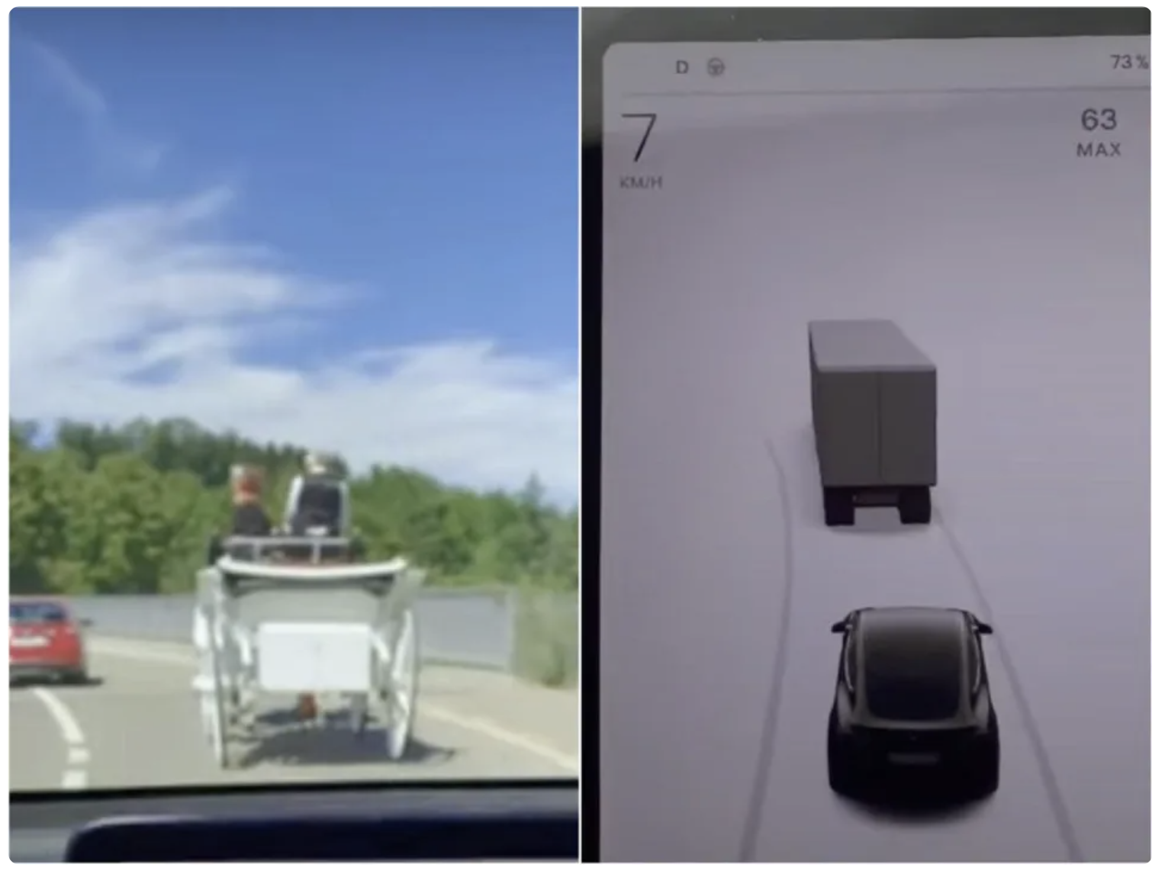
Brittleness with respect to small changes
“Tesla's Autopilot system confusing horse-drawn carriage for truck”
Notes:
Well, ... alongside the apparent progress, there are troubling trends as well.
You take a SOTA system, run it on an instance taken it is used to seeing and things work well.
You make small changes to the instance, and things fall apart.

Slide 72
x Limited data lead to brittle models!

Slide 73
Problem: Diminishing Returns of Scaling

Slide 74
x Scaling models is costly. x There are diminishing returns. Open question: how far can we scale?

Slide 75
Language Interpretation Is Hard
 | What I say | What I mean
Implicit meaning | I didn’t eat anything since this morning | I am hungry
Non-literal meaning | I can eat a horse | I’m really hungry (even though can’t actually eat a horse)
Pragmatics | Do you have some food here? | Please give me some
Common background | There is a new restaurant in the city | ... in the city we’re are in now.

Slide 76
But what is “context”?
”Context” is everything
Seeing
Touching
Hearing
Reading
Notes:
Context = زمینه

Slide 77
x Computers have a narrow access to the world!

Slide 78
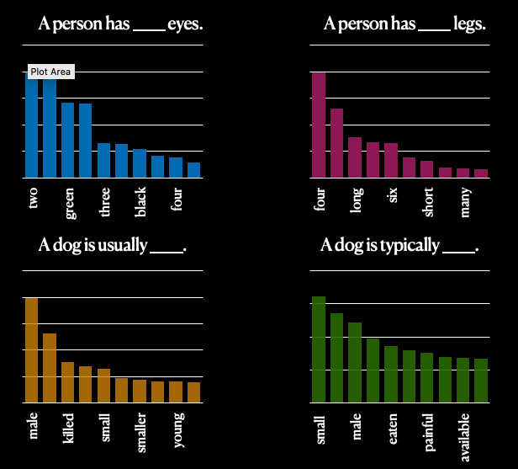
Generated Knowledge is Inaccurate
RoBERTa-large

Slide 79
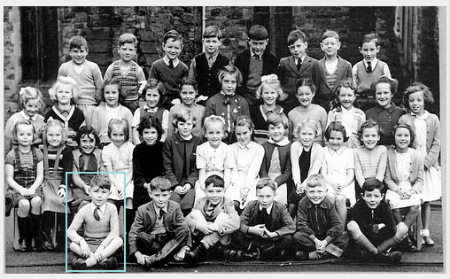


The way forward: learning from additional modalities
last row $⇒$standing
front row $⇒$crossed legged

Slide 80
x Representations are inaccurate and lack commonsense

Slide 81
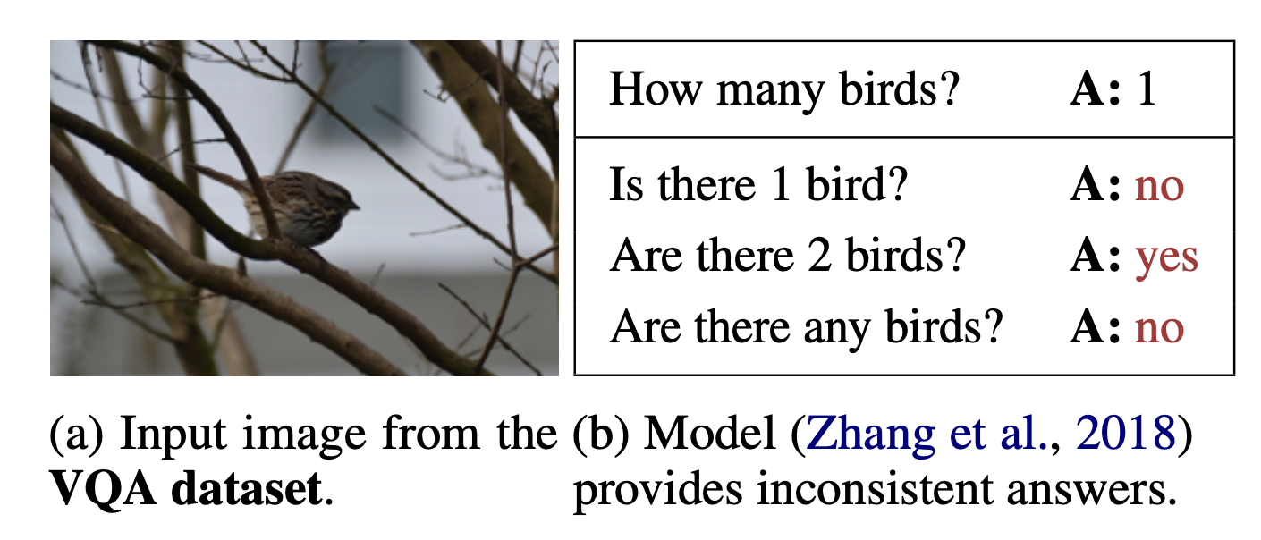
LMs are not Consistent
They do not know what they know!
Ribeiro et al, 2019
Notes:
آن کس که نداند و نداند که نداند در جهل مرکب ابدالدهر بماند

Slide 82
x LMs do not know if they [don’t] know!

Slide 83
Lack of Generality
Successes in NLP are focused on niche domains
language understanding tasks
🤮
Explaining Decisions
Answering Questions
Extracting Entities
Personal Assistants

Slide 84
Breadth of tasks
language understanding problems
puzzles/search problems
SQuAD
HotPotQA
Go
Chess
Depth of tasks
Notes:
Let me show the same point pictorially:
Think of this light blue shape as the space of all the problems we’re interested in.
The X-axis is the collection of problem definitions, or the metaphorical breadth of problems.
For example, problem definitions for Go, for SQuAD, or any other QA task.
The depth is the complexity of each problem space.
For example, within the domain defined by the rules of Go.
Similarly, for any NLP task.
The issue I am alarmed by is that we excessively focus on depth,
We try to make the most sophisticated Go player
Similarly, for NLP models, we try to make the strongest models (for each dataset)
But very little time is spent in the breadth, i.e., building models that support a border range of tasks (i.e., more breads).

Slide 85
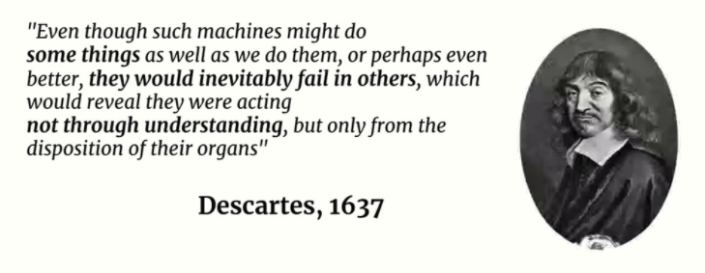
The Paradox of Task-Specific Models
AI models have excelled at solving specific tasks without displaying intelligence.
Slide due to Francois Chollet

Slide 86
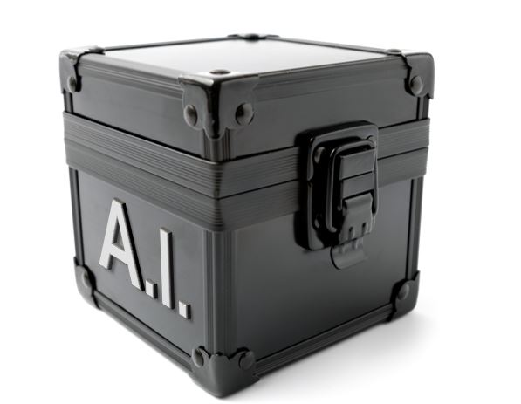
Beyond Task-Specific Models
human readable definitions; fully define the task
Text: She chose to make a salad for lunch tomorrow and Sunday. Question: how long did it take for her to make a salad?
tasks
Question Typing Instructions
Indicate the type of temporal phenomenon in the question …
Question Typing
“event duration”
Question Answering Instructions
In this task we ask you to write answer to the given question. …
Question Answering
“30mins”, “an hour”
Sentence Mod. Instructions
Label a question that is free of any grammatical/logical errors w/ 'yes’ …
Sentence Modification
“how often …”
Instruction define tasks explicitly in natural language.
https://github.com/allenai/natural-instructions
https://github.com/allenai/natural-instructions-expansion
Notes:
The setup that we’re exploring here is an extension of the previous idea, except that instead of task prefixes we have instructions which define each task explicitly in natural language.
unlike task prefixed, instructions are human-readable definitions that are expected to fully define the task
-------
# textual descriptions of the target tasks.
We know humans can understand and execute these instructions.
The question is whether we can enable machines to follow instructions and execute it.

Slide 87
x Current Successes of AI have limited generality!

Slide 88
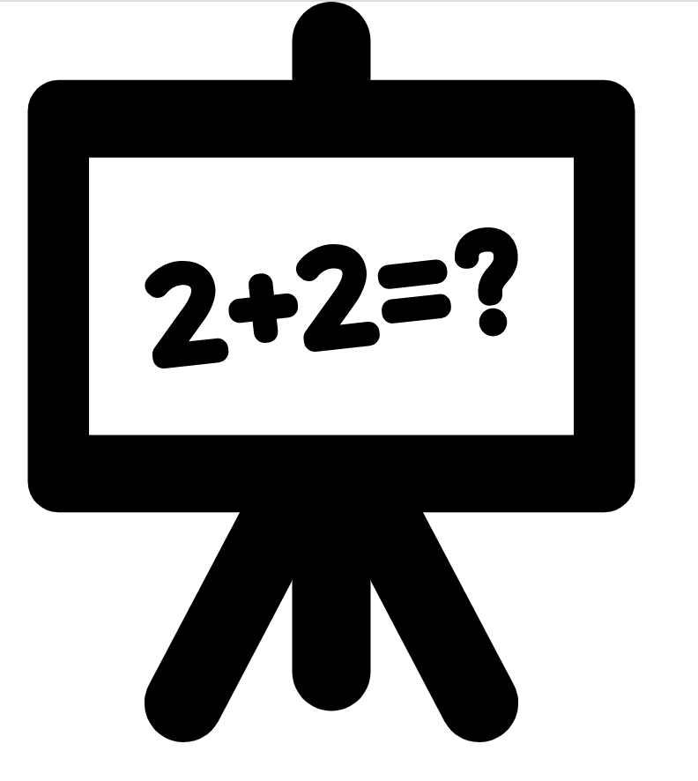

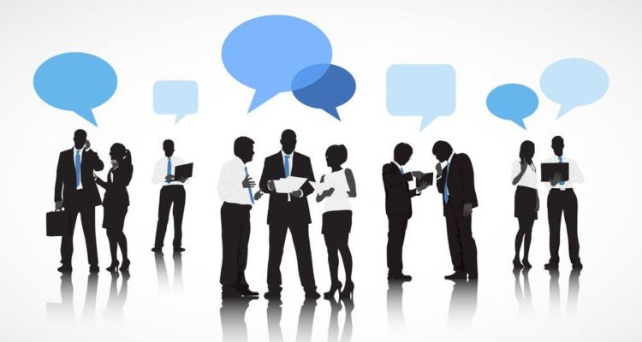
Interactive Semantics
Single-shot evaluation
input problem
evaluation
Learning from interactions
Notes:
The dominant setup in nlp is “single shot” evaluation: given an input instance, a model needs to predict an output on which its accuracy is judged.
People, however, do not communicate in this manner.
Humans interact; there is often back and forth.
This interaction helps humans resolve errors, resolve differences and learn from each other.
I believe we should also move towards such ideas in NLP as well.
I think applications like Google Assistant are very natural testbed for “interactive semantics”.

Slide 89
x How can we incorporate “interactivity” in AI/NLP?

Slide 90
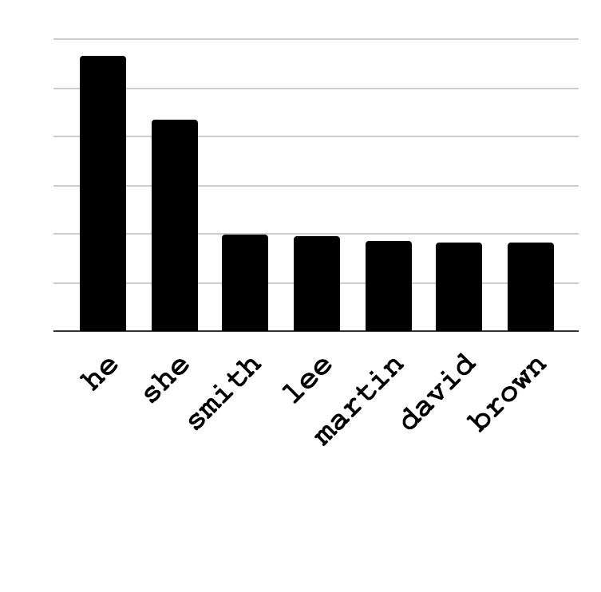
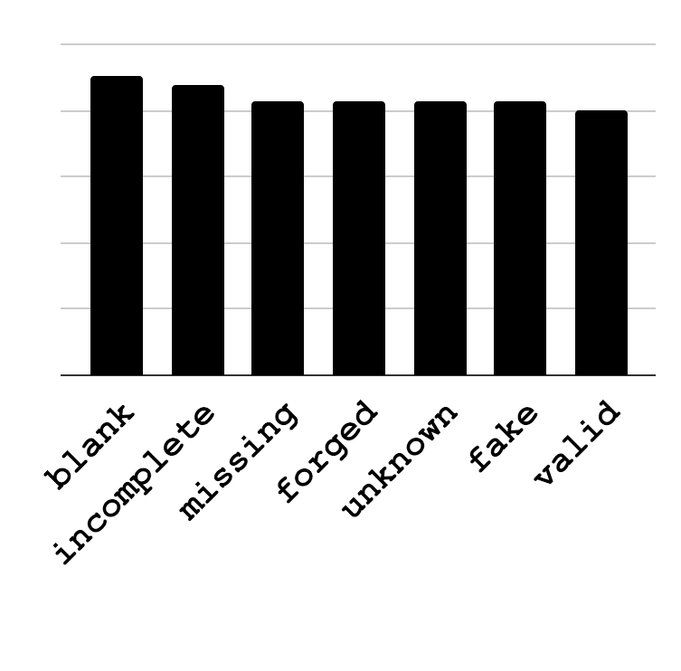
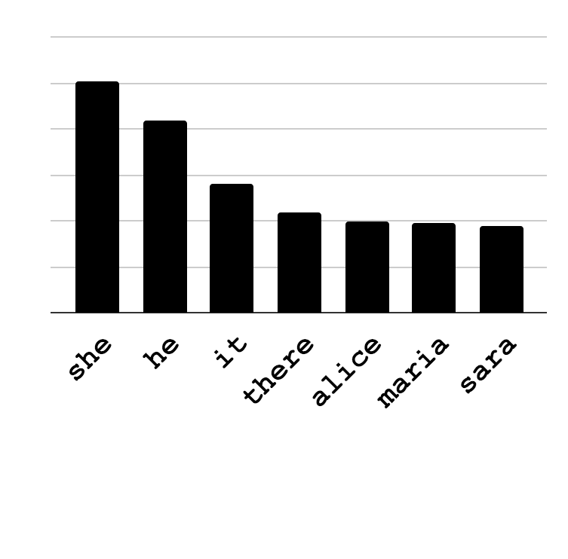
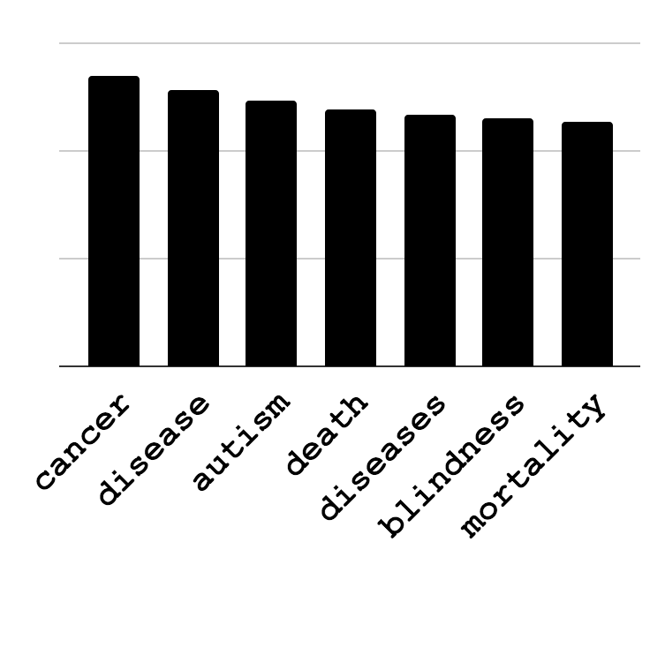
Language Models: Biases
___ is a lawyer.
Obama’s birth certificate is ___.
What does this mean for the NLP systems built out of such systems?
Discovery:
How can we automate the discovery of issues?
Mitigation:
How can we resolve the such biases?
___ is a babysitter.
Vaccines cause ___.
Bias
Conspiracy Theories
[May et al.19; Zhao et al.19]
Notes:
Trained on web data: it shouldn't be of surprise if they are sexist, racist, etc.
Using this *ist model for NLP tasks, what does it entail?
Does this mean my QA system is going to be *st?

Slide 91
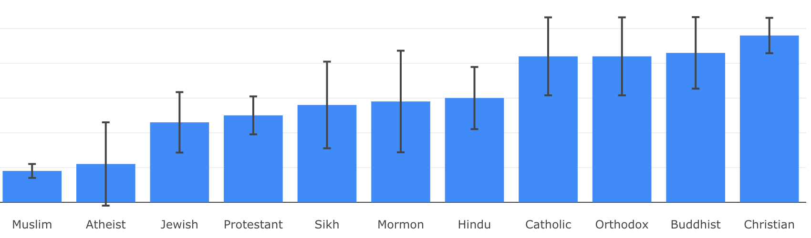
Social Biases of QA Models
Social Biases in QA Models [Li et al. EMNLP-Findings 2020]
Association of ethylic/religious groups with negative stereotypes
https://unqover.apps.allenai.org/

Slide 92






What could go wrong?
1
2
3
Men are better-qualified for this job
woman
Candidate 1 - work 1 - work 2 - PhD
Candidate 2 - work 1 - work 2 - PhD
homemaker
CV filtering model
man
programmer
Biased Input Representations
Uninterpretable Features
Biased Supervision and/or underrepresented groups in the training set

Slide 93
x Models perpetuate social biases!

Slide 94
AI Checklist: Building models that …
✓ seamlessly learn input-output mappings.
✓ don’t need to be trained from scratch every time.
✓ are context-sensitive.
✓ use fewer training examples.
x understand the emergent ability of language models.
x know what they know.
x capture accurate common sense knowledge.
x are interpretable.
x don’t perpetuate social biases.

Slide 95
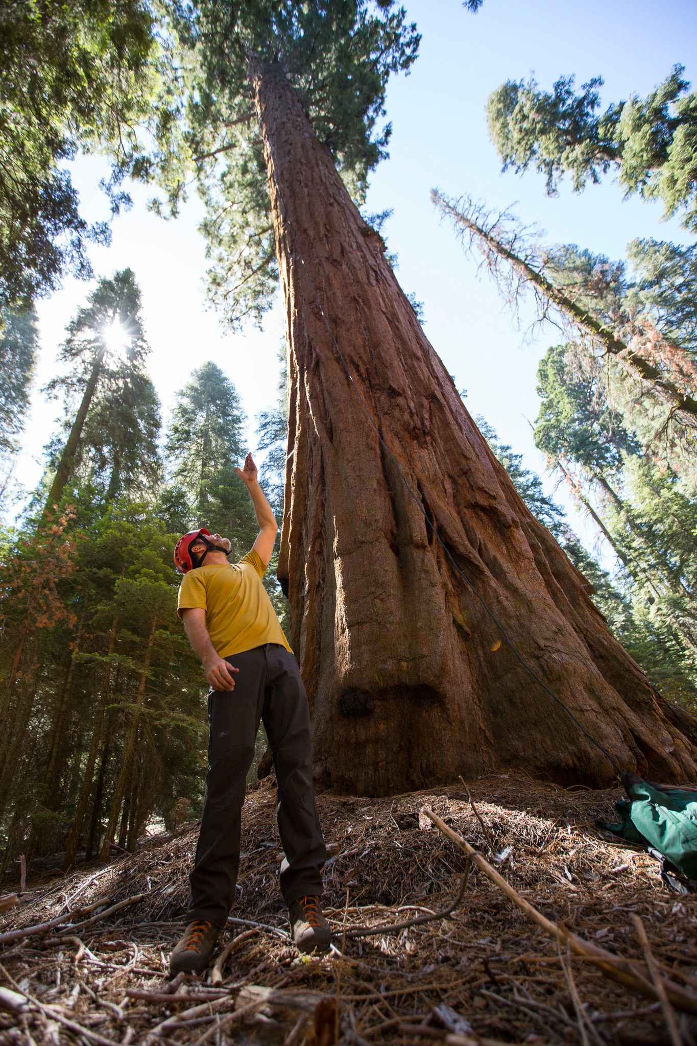
Are we climbing a tree to reach to the moon?
And finally ….

Slide 96
That’s it!
Notes:
That’s all I had, I appreciate your time and attention.

